Slide 1
Northwind Data Insight
Muhammad Rizqiansyah

Slide 2
Objective
Product Analysis
Employee Analysis
Supplier Analysis

Slide 3
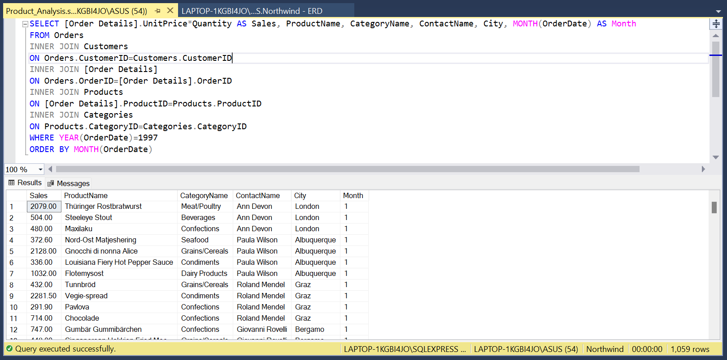
Analysis: Product Analysis
Mennganalisis trend penjualan tiap bulan

Slide 4
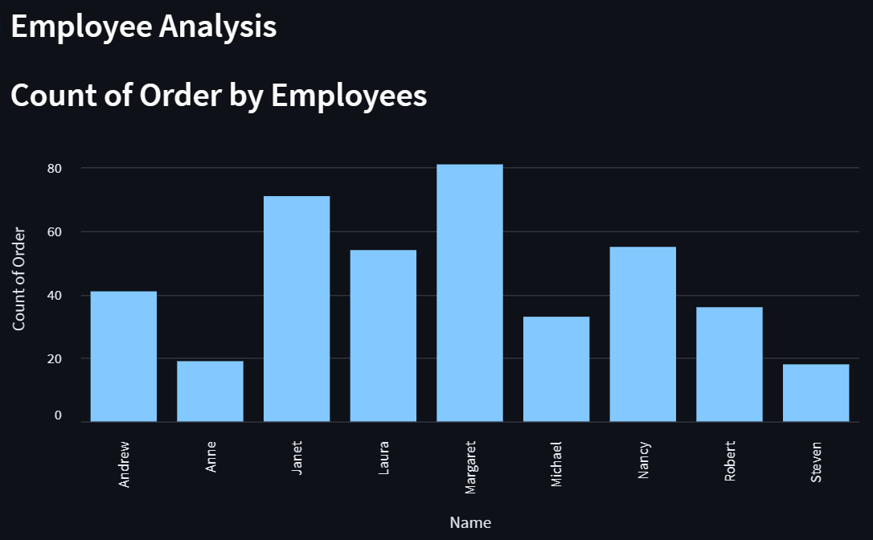
Analysis: Product Analysis
Mennganalisis trend penjualan tiap bulan

Slide 5
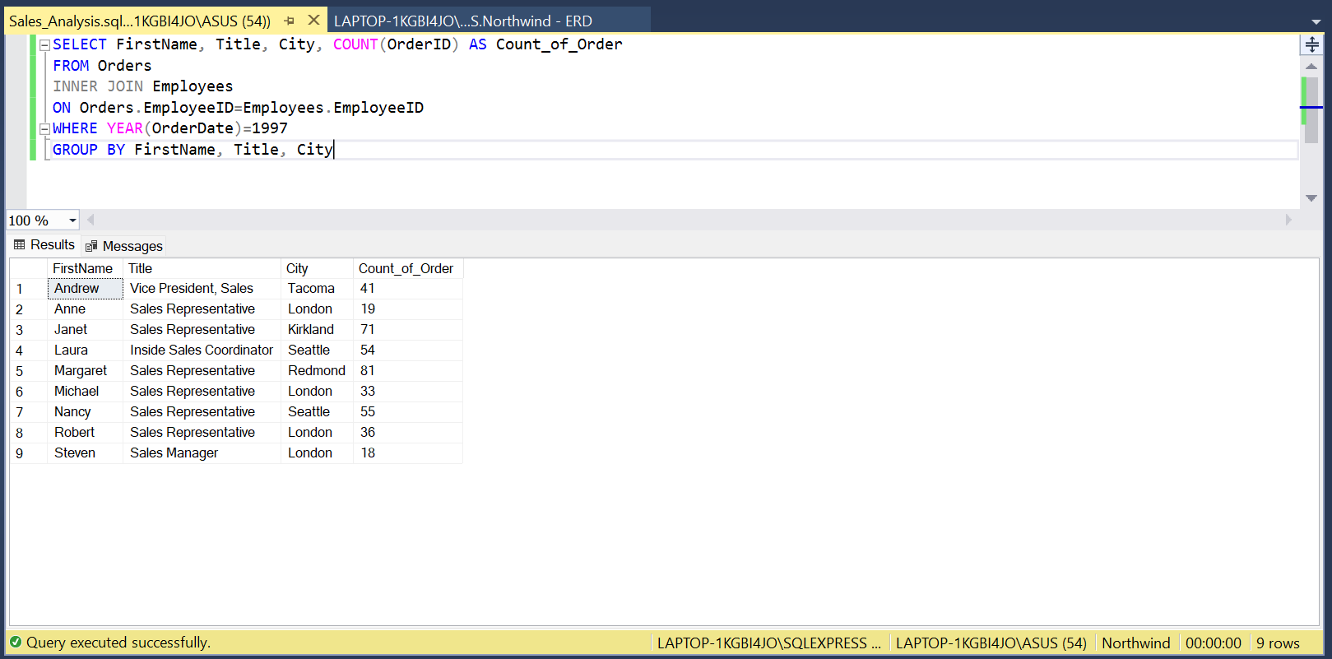
Analysis: Employee Analysis
Mennganalisis data karyawan

Slide 6
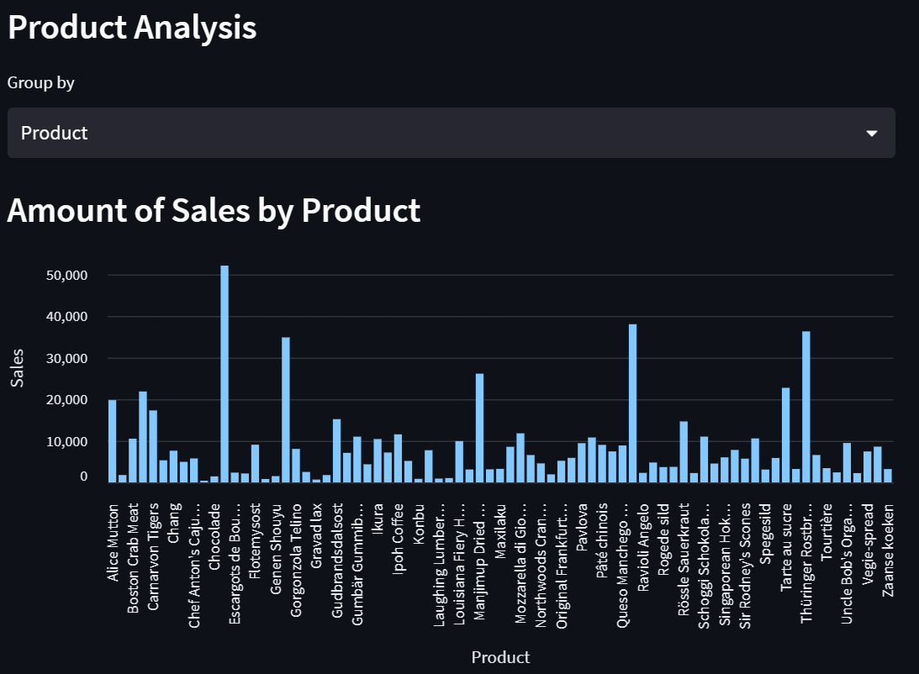
Analysis: Employee Analysis
Mennganalisis data karyawan

Slide 7
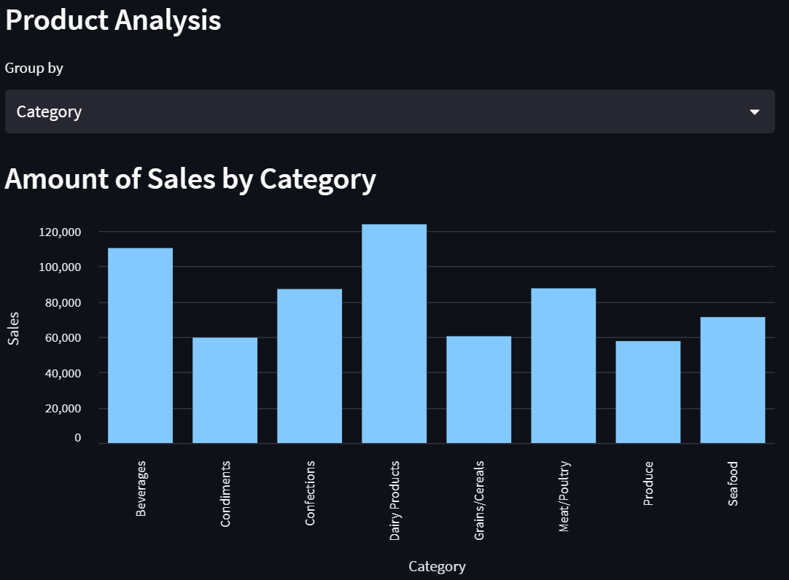
Analysis: Employee Analysis
Mennganalisis data karyawan

Slide 8
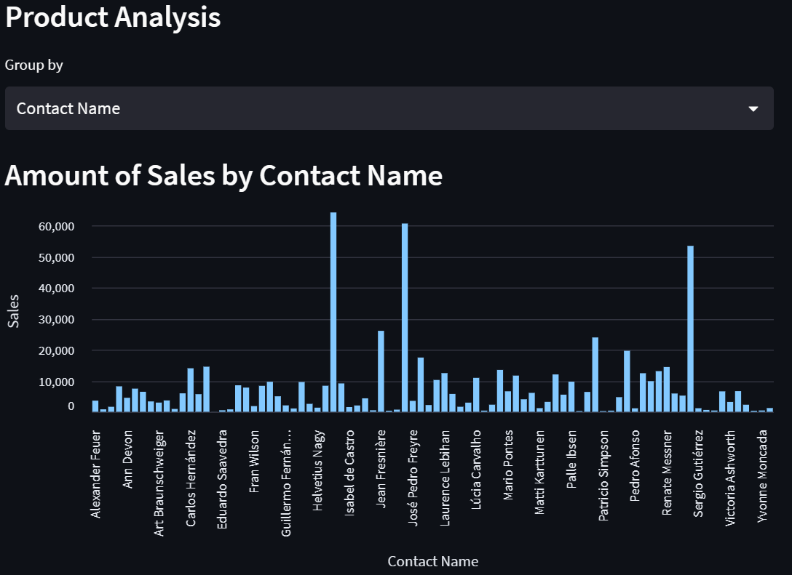
Analysis: Employee Analysis
Mennganalisis data karyawan

Slide 9
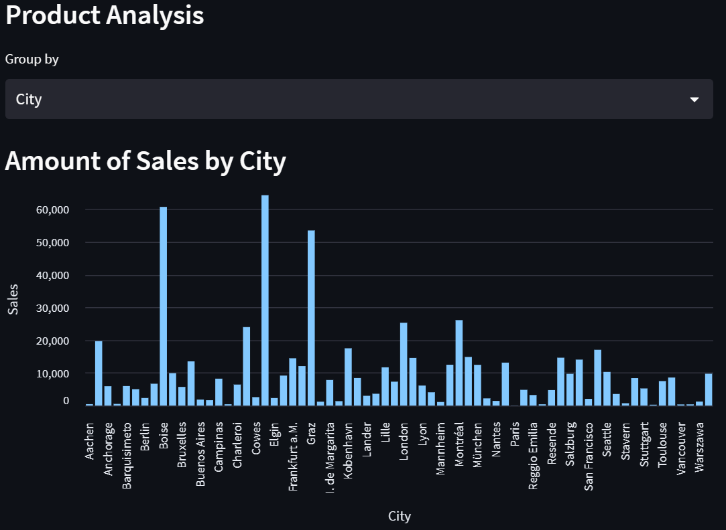
Analysis: Employee Analysis
Mennganalisis data karyawan

Slide 10
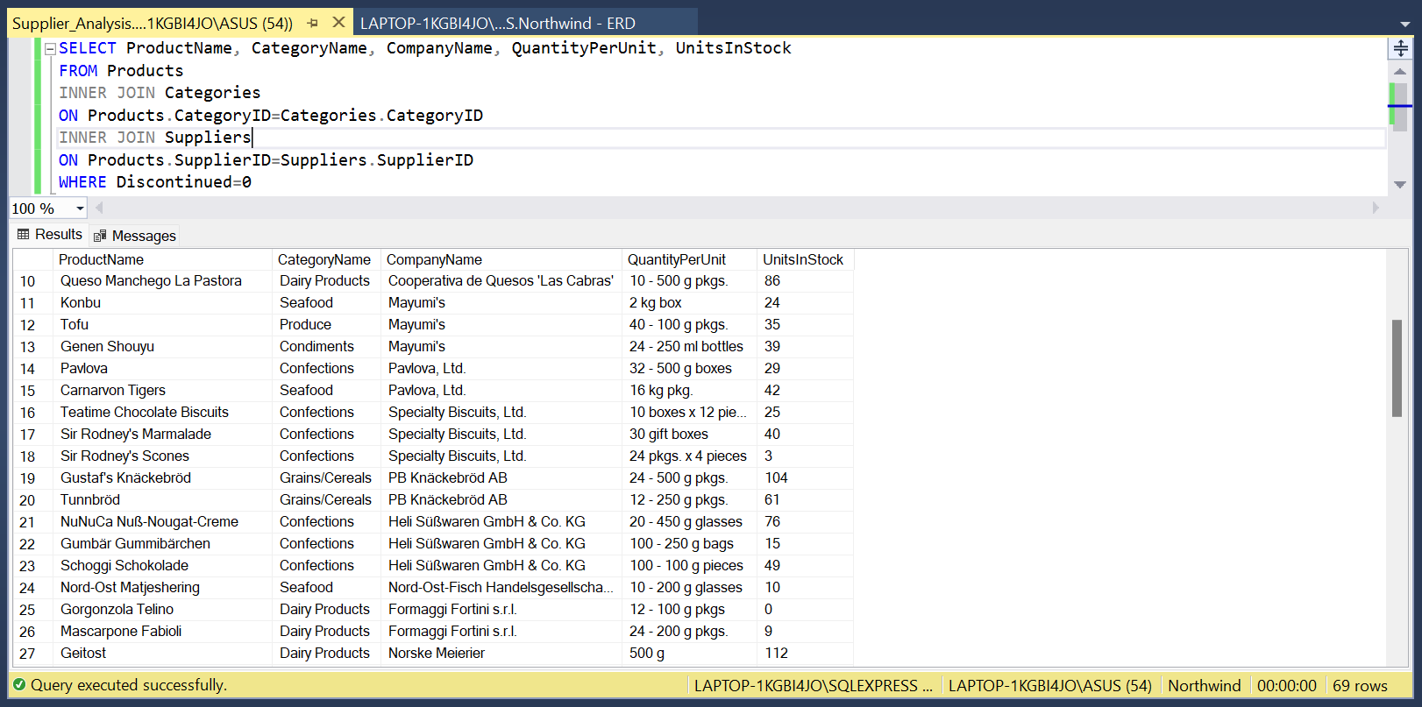
Analysis: Supplier Analysis
Mennganalisis trend penjualan tiap bulan

Slide 11
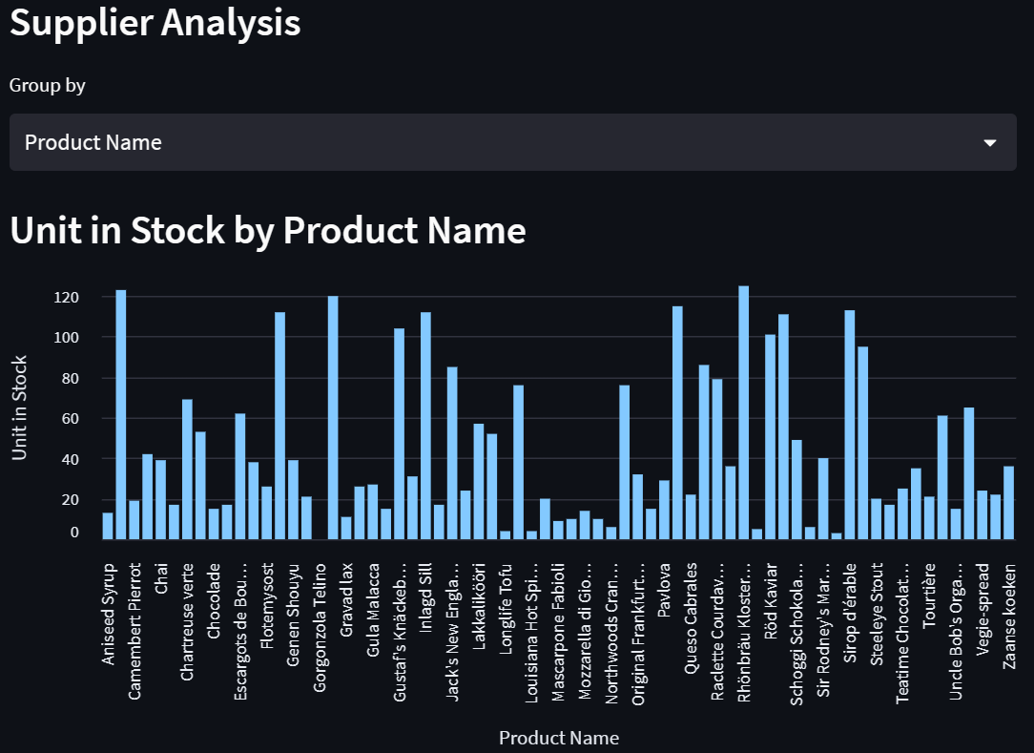
Analysis: Supplier Analysis
Mennganalisis trend penjualan tiap bulan

Slide 12
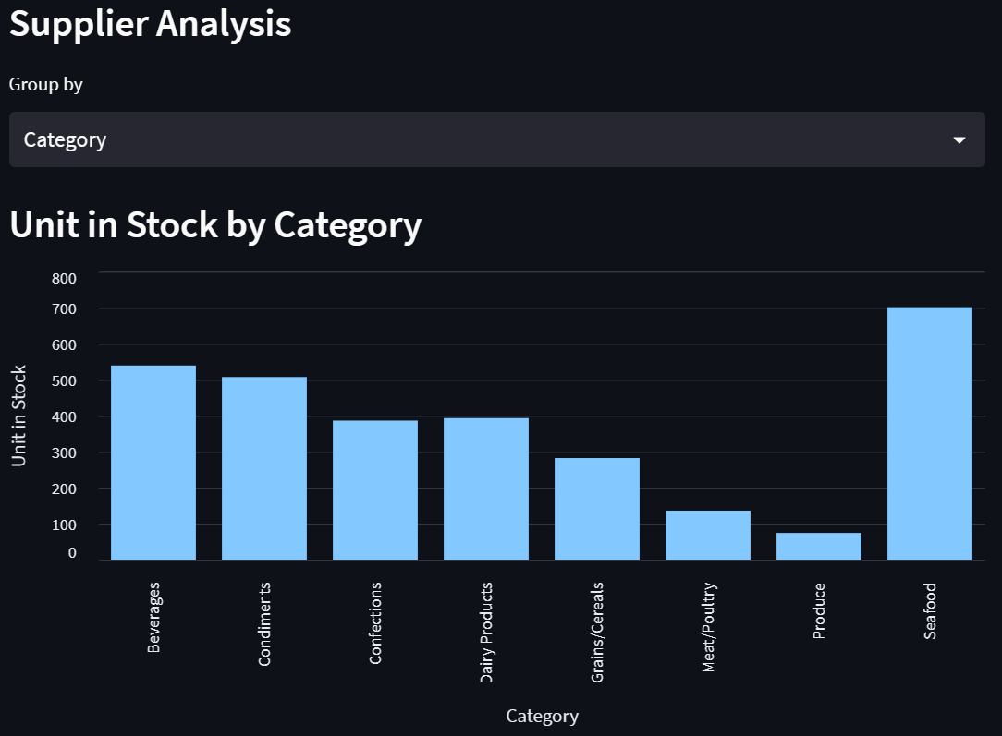
Analysis: Supplier Analysis
Mennganalisis trend penjualan tiap bulan

Slide 13
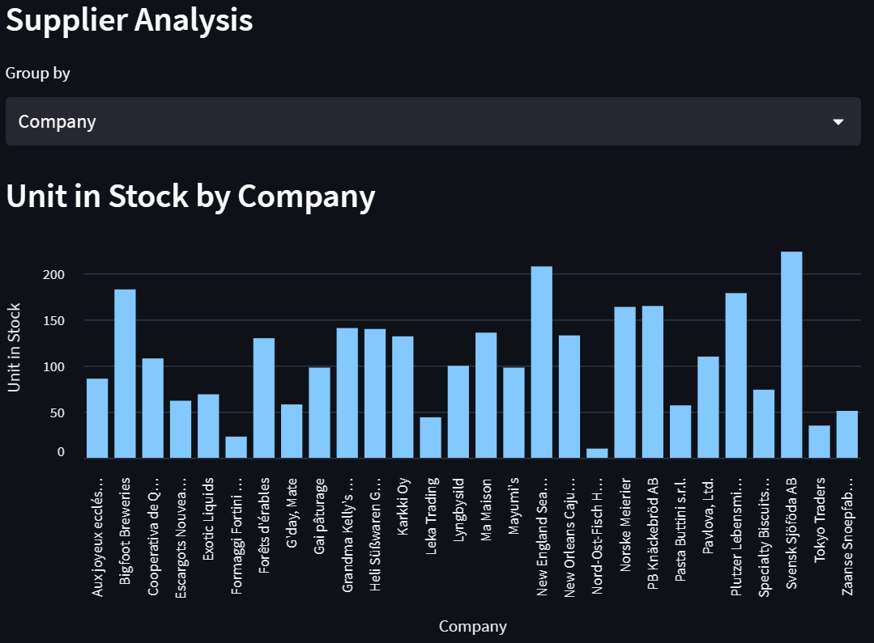
Analysis: Supplier Analysis
Mennganalisis trend penjualan tiap bulan

